Slide 1
Prepare to Upgrade
Name
Title
Microsoft Corporation

Slide 2
Upgrade Cycle
Learn
Prepare
Test
Implement
Validate
Upgrade methods
Document environment
Build test farms
Build/upgrade farms
Troubleshooting
Downtime mitigation
Manage customizations
Plan upgrade strategy
Make items upgradable
Use real data
Evaluate techniques
Find issues early
Deploy customizations
Minimize downtime
Monitor progress
UI/UX issues
Data issues
New capabilities
Upgrade event failures

Slide 3
Prepare to Upgrade
Document Existing Environment

Slide 4
Documentation Process
Examine existing farm for useful information
Gathered information informs new version
Keep all information for future use
Content databases:
Names
Issues
Referenced customizations
Services:
Cross farm topology
Database names
Service Settings
Installed customizations
Farm/Web Application:
Alternate Access Mappings (AAM)
Authentication Methods/Providers
Managed paths
Installed/registered features
Installed customizations
Web.config modifications

Slide 5
Information Gathering Commands
Test-SPContentDatabase
Both 2010 and SharePoint 2013 versions
WinDiff
STSADM -o PreUpgradeCheck no longer exists
STSADM deprecated

Slide 6
Settings Gathering
Some settings are farm specific
Most are needed for the new version farm
At least as a basis for the new farms settings
Simple PowerShell scripts can gather settings data

Slide 7
Customizations Gathering
Solutions
Should always have a build-out directory for FT solutions
Otherwise have to find way to extract FT solutions
Don’t forget admin deployed InfoPath Forms
Special process required to extract them
Sandbox solutions are fine
They come with the content database for free
Other stuff
MSI deployed components
Contact vendor for updates for 2013 support
Highest chance of needing a change due to file/directory placement
XCopy or manually deployed features/files/changes
Should look to packaging in WSP solutions package
Can just deploy to equivalent directory in 2013
Use directory comparisons to be sure you have it all

Slide 8
Performance Assessment
Determine performance in advance of upgrade
Different components have different key metrics
SQL Server(s):
IOPs
Memory
CPU
Network:
Bandwidth
Latency
SharePoint Server(s):
Memory
CPU

Slide 9
Test-SPContentDatabase
Tests content databases against Web Application
Connected content databases
Disconnected/remote farm content databases
Makes no modifications to database/content
Used to detect/report:
Configuration gaps
Orphaned sites
Missing/unregistered customizations
Row sizing for predicting comparative upgrade speeds
Exists in both 2010 and SharePoint 2013
2010 version has subset of SharePoint 2013 abilities

Slide 10
WinDiff Or Other Directory Comparison Tools
Used to compare directories and files
Compare between environments:
Existing environment
Pristine installation at same build level as existing
Ensure no customizations are installed
Compare target locations:
Web Server Extensions
All installed customizations
IIS Web Site directory
Web.config file differences
GAC
All installed and referenced global assemblies
Recommended to save entire directories for future use
May later need files or settings that are missing from new install

Slide 11
Prepare to Upgrade
Plan Upgrade Strategy

Slide 12
Pre-Upgrade Considerations
Disruption vs. Downtime
Performance
Topology
URL Changes
Governance
Notification Plan

Slide 13
Disruption
Defined as any significant change that:
Requires changing client software to match server
Requires retraining to use existing abilities
Requires refactoring/replacement of customizations
Not the same as downtime
Downtime may “disrupt work” but is not capital ‘D’ Disruption
Downtime is temporarily painful, but disruption causes the pain to linger
Use Deferred Site Collection Upgrade to forestall most disruption
Most existing customizations should keep working without change
Switch to 15 mode only once customizations have matching SharePoint 2013 updates

Slide 14
Downtime
No such thing as zero downtime!!!
Try to address this fallacy whenever possible
Usually “none” really means as little as possible
Negotiate to what is acceptable/affordable
When “none” really means none, it’s a big problem
Tradeoff data loss against outage reduction
Upgrade of parallel copy and use migration tools to backfill
Possible to reduce downtime using mitigation processes:
Read-only state while upgrading copy in background
Requires more hardware to accomplish
Has ability to roll back if upgrade is unsuccessful
Parallel database upgrades to improve throughput
Parallelism has its limits though and can actually hurt performance at scale

Slide 15
Performance
Know what performance you have and what you want
Its horrible to succeed in upgrade but have the farm limping afterwards
Audit existing hardware and performance
Is there new hardware available for SharePoint 2013?
If not, is the existing hardware sufficient?
What is the current usage and SQL performance?
What is current network bandwidth and latency?
Is existing content farm sufficient to support a double crawl?
Audit existing content
Database upgrade performance variables
Site Collection upgrade performance variables

Slide 16
Predicting Database Upgrade Performance
Database
# Site Collections
# Webs
# Lists
# Documents
# Links
Overall database size
Environment
Simultaneous upgrades
SQL server disk I/O per second
SQL server database to disk layout
SQL server temp DB optimizations
SQL server CPU & memory
SharePoint server CPU & memory
Network bandwidth & latency
Note:
Each new build’s upgrade can be impacted by newly added upgrade actions and database content changes since last upgrade

Slide 17
Predicting Site Collection Upgrade Performance
Site Collection
# Webs
# Lists
# Activated upgrading features
# Documents
# Links
Environment
Simultaneous upgrades
SQL server disk I/O per second
SQL server database to disk layout
SQL server temp DB optimizations
SQL server CPU & memory
SharePoint server CPU & memory
Network bandwidth & latency
Note:
Each new build’s upgrade can be impacted by newly added upgrade actions and Site Collection content changes since last upgrade

Slide 18
Topology
Farm configuration
WAC no longer part of same farm
May have additional hardware requirements
Needs WOPI setup to use remote WAC instance
Federated farm services
2010 content farm can consume SharePoint 2013 shared services
Allows upgrade of services farm first
SharePoint 2013 farms cannot consume 2010 services

Slide 19
URL Changes
Should avoid URL changes whenever possible
WebDav does not follow redirects so Microsoft Office applications may not work as desired against new URLs
Bookmarks to “old” URLs break once upgrade has completed
Stacking URL changes with upgrade can complicate experience
Recommend to do them as separate events with user noticeable time gap between
Could make users blame upgrade as cause of experience change
Shouldn’t even use different URLs in test environment
Plan to not change URLs in the future
If you have to do it, plan well so it should never occur again

Slide 20
Governance
Determine control and rollout of upgrade abilities
When to unlock creating new 15 mode Site Collections
When to allow upgrade of existing Site Collections
Whether to give Site Collection Admins control or not
Web Application and Site Collection variables control this:
SPWebApplication.CompatibilityRange *
“OldVersions”, “Old”, 14 – Allow creating 14 mode sites only
“AllVersions”, “All”, “14,15” – Allow creating both 14 and 15 mode sites
“NewVersions”, “New”, 15 – Allow creating 15 mode sites only
SPSite.AllowSelfServiceUpgrade
Cleared using SPSite.InheritAllowSelfServiceUpgradeSetting

Slide 21
Notification Plan
Plan to inform users about upcoming upgrade requirements/events
Surprises are good for birthdays, not so on business time
Include info on what will happen
Will read-only environment be available or not
What if roll-back needs to occur
Indicate when upgrade will occur
Provide guidance on window when upgrade will start and finish
Provide directions if using self-service upgrade abilities
Upgrade available notification email
Indicate when upgrade must be completed by
Self-service upgrade means getting people to do it eventually
Indicate when upgrade is finished
Let them know with the all clear signal or that rollback occurred

Slide 22
Choosing Migration vs. Upgrade
When
When upgrade is not possible due to bad prior choices
Database modifications
Unsupported site definitions
When downtime is not tolerable
Why
Cost of downtime is higher than negative impact from migration
Massive redesign is required to site/data structures
How
Migrate using 3rd party tools only, no Microsoft supplied solution

Slide 23
Prepare to Upgrade
Manage Customizations

Slide 24
Evolution Of Customizations
Product release cycles are a form of evolution
Customizations dependent on a product are affected
Some live on relatively unchanged
Some change dramatically but continue on
Many die off
Due to circumstance
e.g. developer left and no source, vendor out of business
If non-adaptable
e.g. designed into a corner
Takeaway is that you need to plan for evolution and even cleanup of customizations
All customizations have a lifecycle, plan for it right from the beginning

Slide 25
Customization Categories and Types
Visually impacting
Master Pages
Themes
Web Pages
Web Parts
Data structure impacting
Content Types
List Types
Web Templates
Site Definitions
Non-visually impacting
Web Services
HTTP Handler
HTTP Module
Windows Services

Slide 26
Visual Impacting Customizations
Most likely to not work well with 15 mode user experience
.CSS dependencies
.JS dependencies
Theme dependencies
UI control dependencies
UI behavior dependencies
Usually should still work in 14 mode
Shouldn’t block farm upgrade
Needs to be addressed before Site Collection upgrade
Test carefully in both 14 and 15 modes

Slide 27
Data Structure Impacting Customizations
Highest likelihood to cause blocking issues during upgrade if missing
E.g. Missing feature with list schema means list won’t render
Can be modified during upgrades, but are usually expensive changes
Iterate over every instance to update
Instantiation and updating needs to handle conflicting customizations
E.g. Conflicting path or column names

Slide 28
Non-Visually Impacting Customizations
Highest likelihood to be incompatible with SharePoint 2013
Dependencies on existing services structure or topology
Deeper API and security dependencies
Deep dependency on page rendering pipeline
Higher chance of impacting performance
Test carefully, these are sometimes only found by deep testing
E.g. finding exceptions when exercising all code paths
Can sometime express issues by impacting other behaviors
E.g. HTTP handlers interfering with rendering pipeline
Be prepared to replace or remove if necessary
Check to see if the system works correctly without the customization

Slide 29
3rd Party Customizations
Customers usually don’t have the ability to fix issues in product without help
Source code rarely available
Need to work closely with 3rd party to get updates to work with SharePoint 2013
May require additional special upgrade instructions
3rd party applications can include following which have higher possibility of issues:
Windows services
Windows applications
Web applications
HTTP modules
MSI installed 2010 customizations may be incompatible with SharePoint 2013
Check with 3rd party for updated SharePoint 2013 compatible MSIs
In some cases consider re-evaluating the value of the component with the new version farm
Out of box features may be viable alternative
Some 3rd party products modify the SharePoint content databases
Absolutely not supported, ever!
Recommended to remove from environment until 3rd party provides solution that does not modify databases

Slide 30
Prepare to Upgrade
Environment Cleanup

Slide 31
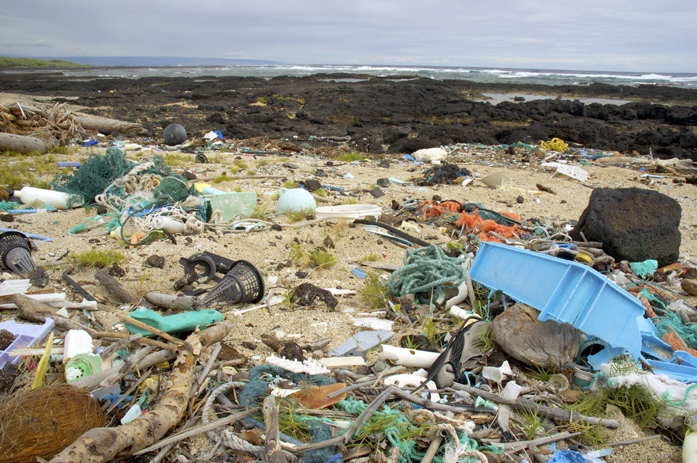
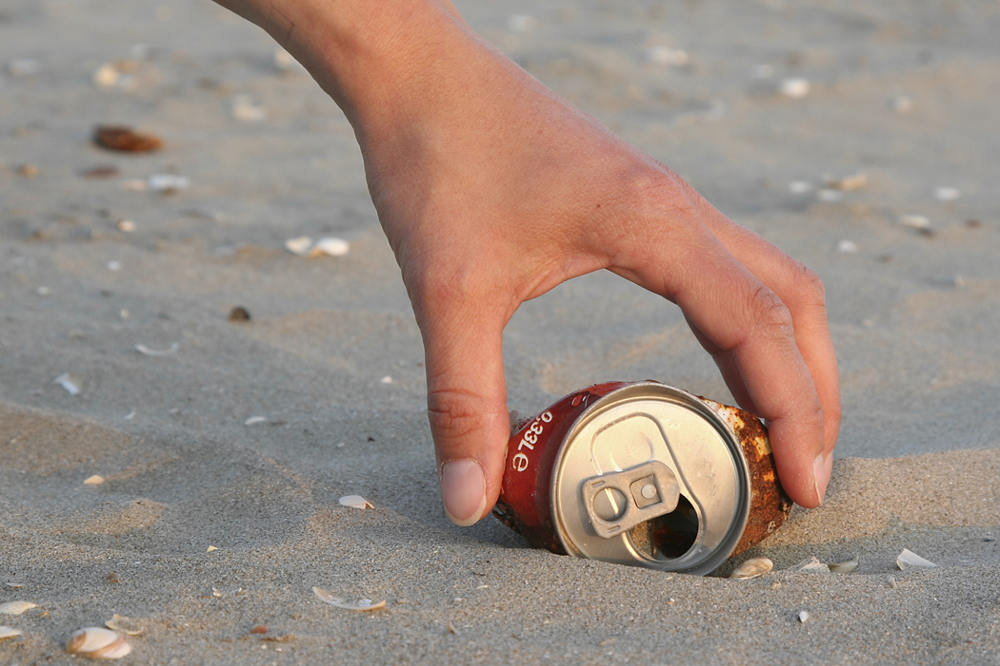
Environment Cleanup
It’s a dirty job…
…but someone has to do it

Slide 32
Spring Cleaning For A Healthy Farm
Cleanup existing 2010 farm before upgrade
Delete stale SPSites and SPWebs
stsadm -o DeleteSite [-force] [-gradualdelete]
stsadm -o DeleteWeb [-force]
Remove extraneous document versions
Primarily user driven, OM operations or tools help
Cleanup templates, features, & web parts
Primarily user driven, OM operations or tools help
Finish Visual Upgrades to 14
Repair data issues
stsadm -o DatabaseRepair [-deletecorruption]
stsadm -o ForceDeleteList
stsadm -o VariationsFixupTool

Slide 33
Completing Visual Upgrade
Run VisualUpgrade method on all remaining sites
PowerShell can do this easily
Get-SPSite | ForEach-Object {$_.VisualUpgradeWebs()}
Will occur during content database upgrade on 15 farm
Content Database level upgrade action
Better to do this on 14 farm prior to upgrade:
To address issues while v3 components still exist
To get end users involved early if necessary
To allow rollback temporarily if needed
To not stack faults during content database upgrade
To not cause UX changes during content database upgrade

Slide 34
Site Collection End of Life
PowerPoint Broadcast Sites
Site Definition based template was included in WAC
WAC moved off of farm, template ceased support
Existing sites not supported on 15 even in 14 mode
Only option is to find and remove instances
Can find sites by PowerShell
Get-SPSite | Where-Object {$_.RootWeb.Template -eq “PowerPoint Broadcast #0”}
Can remove site using PowerShell
Get-SPSite | Where-Object {$_.RootWeb.Template -eq “PowerPoint Broadcast #0”} | Remove-SPSite

Slide 35
Feature End of Life
Best time to remove a feature is during site collection upgrade
Causes least impact on users
Simple feature can be removed with template upgrade
DeprecateSimpleFeature
Only for Simple Features though, don’t use for complex ones
Complex feature can be removed using feature upgrade
Use feature upgrade code callout
Allows clean up of artifacts
Can self-remove instance

Slide 36
Prepare to Upgrade
Conclusion
Notes:
Document Existing Environments
Plan Upgrade Strategy
Manage Customizations
Environment Cleanup

Slide 37
Q&A

Slide 38

© 2012 Microsoft Corporation. All rights reserved. Microsoft, Windows, Windows Vista and other product names are or may be registered trademarks and/or trademarks in the U.S. and/or other countries.
The information herein is for informational purposes only and represents the current view of Microsoft Corporation as of the date of this presentation. Because Microsoft must respond to changing market conditions, it should not be interpreted to be a commitment on the part of Microsoft, and Microsoft cannot guarantee the accuracy of any information provided after the date of this presentation. MICROSOFT MAKES NO WARRANTIES, EXPRESS, IMPLIED OR STATUTORY, AS TO THE INFORMATION IN THIS PRESENTATION.

